Slide 1






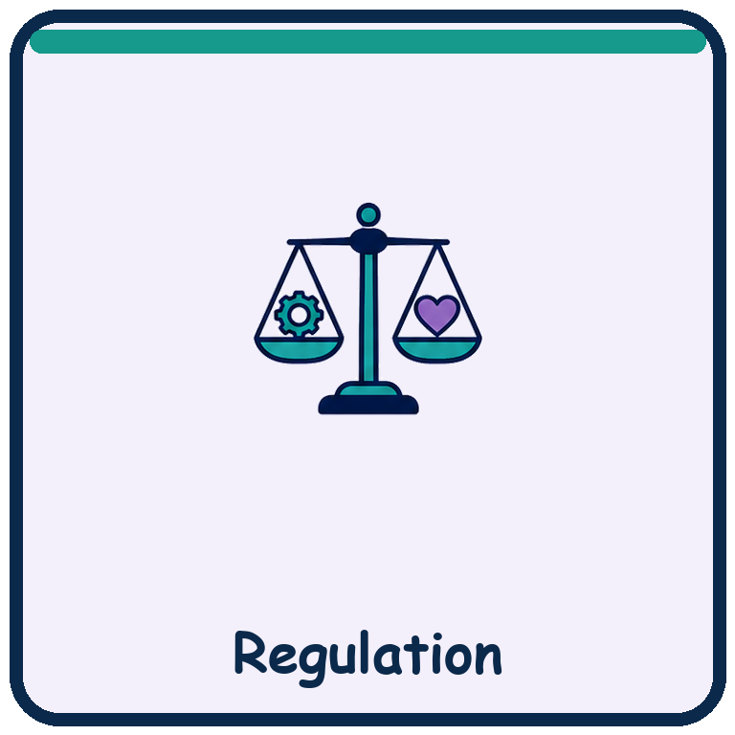
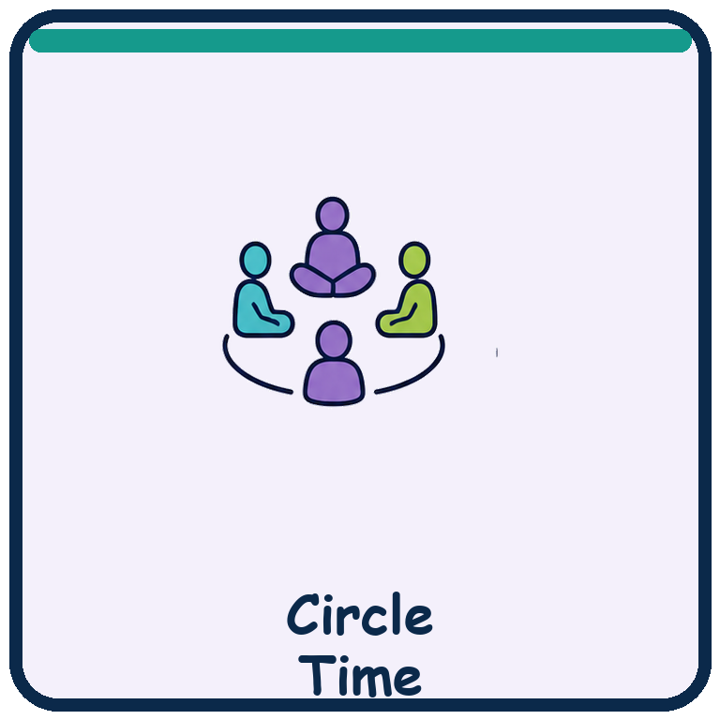

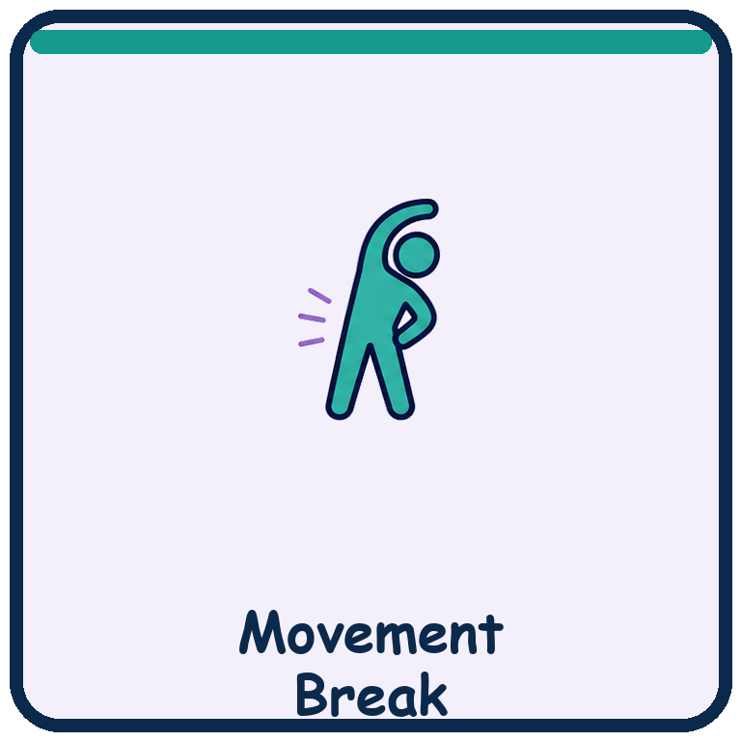
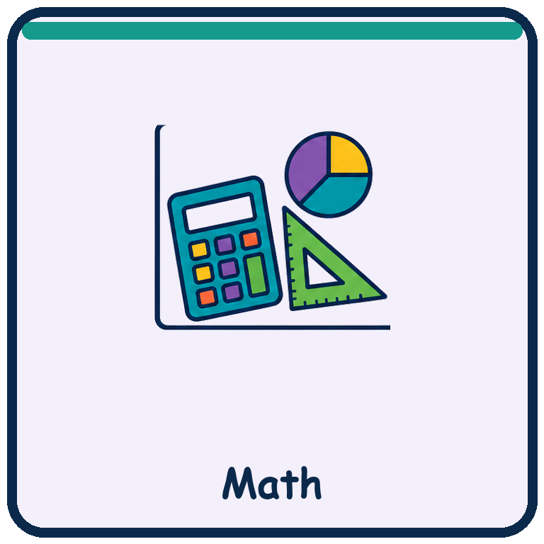
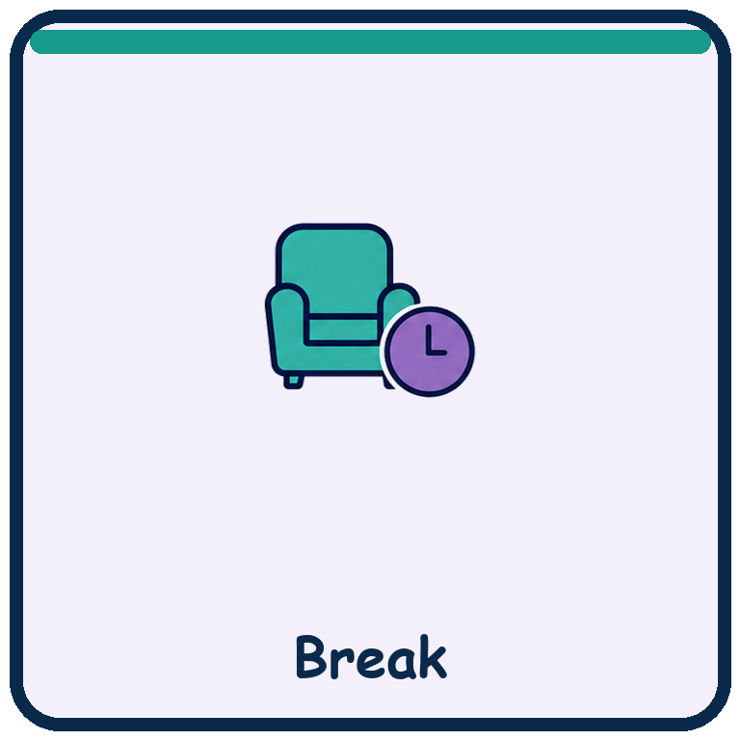
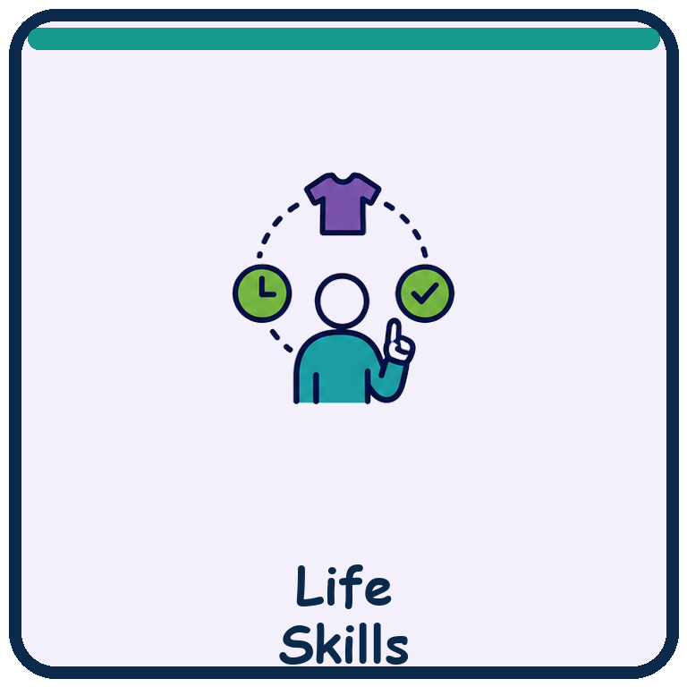
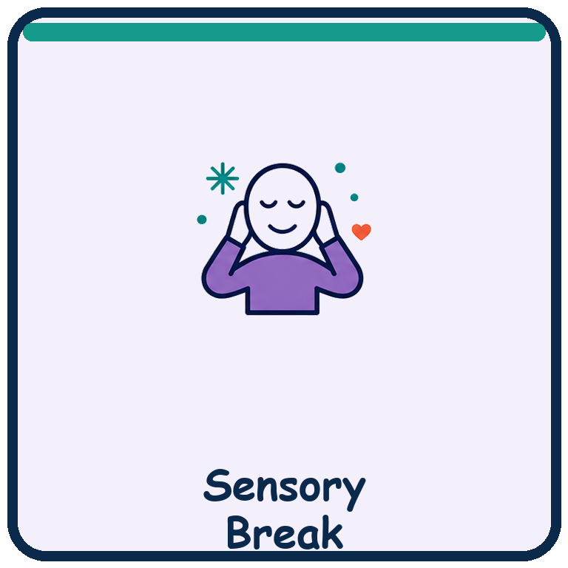

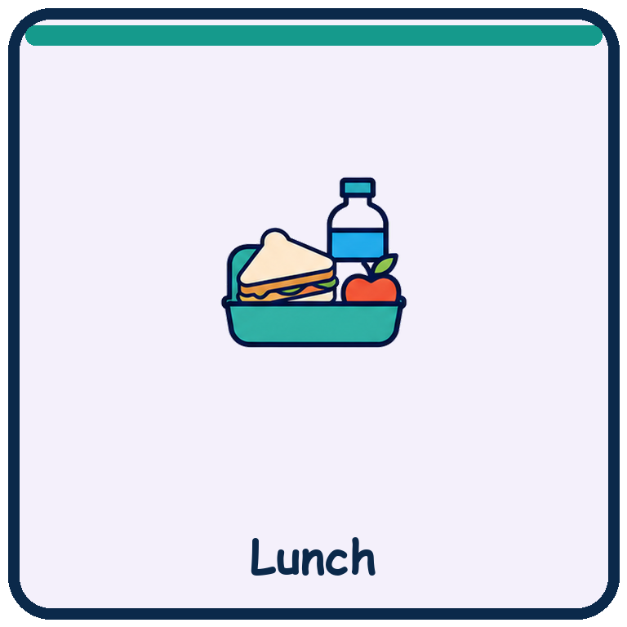
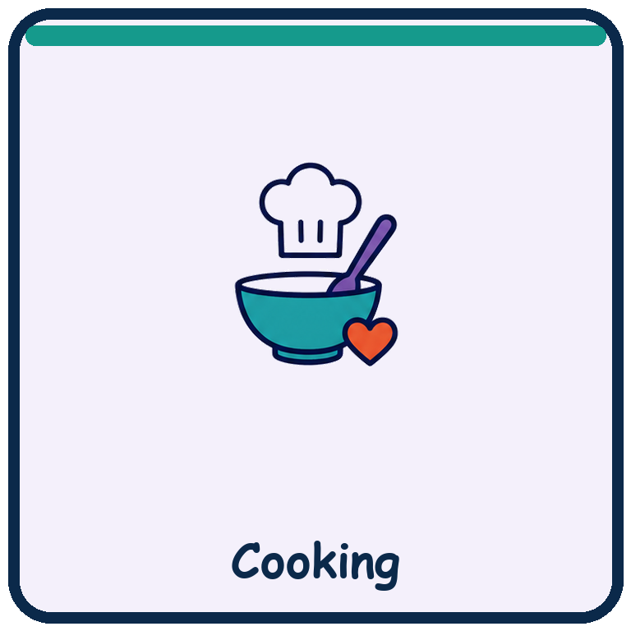
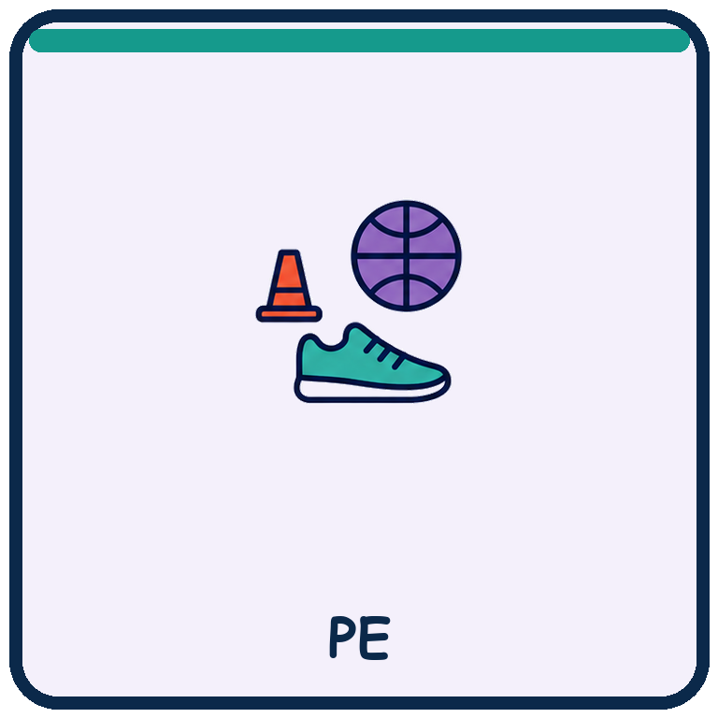

MY JOURNEY • YEAR 1 • UNIT 1
WEEK 1 VISUAL TIMETABLE • MY VOICE AND ACCESS
Break • stop • help • change • finished are available all day
TIME
& ACTIVITY
Monday
Tuesday
Wednesday
Thursday
Friday
8:30
Arrival & regulation
Arrival
Arrival
Arrival
Arrival
Arrival
8:45
Circle: Ready
Circle
Circle
Circle
Circle
Circle
9:00
English & communication
English
English
English
English
English
9:45
Movement break
Movement
Movement
Movement
Movement
Movement
10:00
Mathematics
Math
Math
Math
Math
Math
10:40
Break / snack
Break
Break
Break
Break
Break
11:00
My Journey / Life Skills
S1 • My Journey
S2 • My Journey
S3 • My Journey
S4 • My Journey
S5 • My Journey
11:50
Sensory regulation
Regulation
Regulation
Regulation
Regulation
Regulation
12:05
Science / inquiry
Science
Science
Science
Science
Science
12:45
Lunch & personal routines
Lunch
Lunch
Lunch
Lunch
Lunch
1:30
Cooking / practical
Cooking
Cooking
Cooking
Cooking
Cooking
2:15
PE / outdoor movement
PE
PE
PE
PE
PE
2:45
Reflect & home
Reflect & home
Reflect & home
Reflect & home
Reflect & home
Reflect & home
HIGH DEMAND • explicit learning
LOW DEMAND • regulate & recover
Routes are fluid • AAC and access supports stay available
Notes:
[Sources]
Layout reference: user-provided Copy of Brooker Visual Timetable 2024 - 2025.pdf.
Symbols: user-provided School Visual Timetable.pdf; selected only where they match the My Journey Week 1 plan.
Curriculum: My Journey Year 1, Unit 1 - I Belong, Week 1 - My Voice and Access.
Learning Model: https://myjourneycurriculum.com/framework.
This slide adapts the supplied weekly grid format for the five-day My Journey Week 1 rhythm.

Slide 2
MONDAY • EXPLORE & ASSESS
Session 1 • Communication in action
Notice how I communicate and show a reliable response.
My communication system stays with me • break, stop and help are available throughout the day
8:30
Arrival & regulation
Check in • AAC ready • choose support
ROUTINE
8:45
Circle: Ready
Preview today • confirm changes
LOW
9:00
English & communication
Explore ways people communicate • make one real choice
HIGH
9:45
Movement break
Choose movement or a quiet alternative
LOW
10:00
Mathematics
Tally response modes • show one total
HIGH
10:40
Break / snack
Break • snack • toilet • quiet recovery
LOW
11:00
My Journey / Life Skills
Baseline communication and access record
HIGH
11:50
Sensory regulation
Use a chosen, approved support
LOW
12:05
Science / inquiry
Test a signal and an observable response
HIGH
12:45
Lunch & personal routines
Lunch • communication • personal routines
LOW
1:30
Cooking / practical application
Choose • reject • help • comment
HIGH
2:15
PE / outdoor movement
Start • continue • change • stop • break
LOW
2:45
Show, reflect & home
Show learning • reflect • home
LOW
BELONG • CONNECT • LEARN • ACHIEVE • GROW
Notes:
[Sources]
Layout reference: user-provided Copy of Brooker Visual Timetable 2024 - 2025.pdf.
Symbols: user-provided School Visual Timetable.pdf; selected only where they match the My Journey Week 1 plan.
Curriculum: My Journey Year 1, Unit 1 - I Belong, Week 1 - My Voice and Access.
Learning Model: https://myjourneycurriculum.com/framework.
Daily low-load view for Monday, aligned with Session 1 • Communication in action.

Slide 3
TUESDAY • EXPLICIT TEACHING
Session 2 • My messages matter
Use yes, no, help, stop, break or finished.
My communication system stays with me • break, stop and help are available throughout the day
8:30
Arrival & regulation
Check in • AAC ready • choose support
ROUTINE
8:45
Circle: Ready
Preview today • confirm changes
LOW
9:00
English & communication
Learn functional messages across speech, sign, AAC and print
HIGH
9:45
Movement break
Choose movement or a quiet alternative
LOW
10:00
Mathematics
Make a yes / no / not sure tally
HIGH
10:40
Break / snack
Break • snack • toilet • quiet recovery
LOW
11:00
My Journey / Life Skills
Practice messages that change what a partner does
HIGH
11:50
Sensory regulation
Use a chosen, approved support
LOW
12:05
Science / inquiry
Continue • change • stop • help
HIGH
12:45
Lunch & personal routines
Lunch • communication • personal routines
LOW
1:30
Cooking / practical application
Yes • no • help • stop • finished
HIGH
2:15
PE / outdoor movement
Offer choice • wait • honor stop and break
LOW
2:45
Show, reflect & home
Show learning • reflect • home
LOW
BELONG • CONNECT • LEARN • ACHIEVE • GROW
Notes:
[Sources]
Layout reference: user-provided Copy of Brooker Visual Timetable 2024 - 2025.pdf.
Symbols: user-provided School Visual Timetable.pdf; selected only where they match the My Journey Week 1 plan.
Curriculum: My Journey Year 1, Unit 1 - I Belong, Week 1 - My Voice and Access.
Learning Model: https://myjourneycurriculum.com/framework.
Daily low-load view for Tuesday, aligned with Session 2 • My messages matter.

Slide 4
WEDNESDAY • PRACTICE & REASON
Session 3 • Communication Quest
Use request, reject, comment, question and repair.
My communication system stays with me • break, stop and help are available throughout the day
8:30
Arrival & regulation
Check in • AAC ready • choose support
ROUTINE
8:45
Circle: Ready
Preview today • confirm changes
LOW
9:00
English & communication
Sort and use communication functions
HIGH
9:45
Movement break
Choose movement or a quiet alternative
LOW
10:00
Mathematics
Build a pictograph of communication functions
HIGH
10:40
Break / snack
Break • snack • toilet • quiet recovery
LOW
11:00
My Journey / Life Skills
Complete authentic Communication Quest missions
HIGH
11:50
Sensory regulation
Use a chosen, approved support
LOW
12:05
Science / inquiry
Create, test and repair a shared signal
HIGH
12:45
Lunch & personal routines
Lunch • communication • personal routines
LOW
1:30
Cooking / practical application
Choose • request • comment • question • repair
HIGH
2:15
PE / outdoor movement
Choose a role • ask • change • repair
LOW
2:45
Show, reflect & home
Show learning • reflect • home
LOW
BELONG • CONNECT • LEARN • ACHIEVE • GROW
Notes:
[Sources]
Layout reference: user-provided Copy of Brooker Visual Timetable 2024 - 2025.pdf.
Symbols: user-provided School Visual Timetable.pdf; selected only where they match the My Journey Week 1 plan.
Curriculum: My Journey Year 1, Unit 1 - I Belong, Week 1 - My Voice and Access.
Learning Model: https://myjourneycurriculum.com/framework.
Daily low-load view for Wednesday, aligned with Session 3 • Communication Quest.

Slide 5
THURSDAY • APPLY & CONNECT
Session 4 • Access tools help me participate
Choose, request or direct an access support.
My communication system stays with me • break, stop and help are available throughout the day
8:30
Arrival & regulation
Check in • AAC ready • choose support
ROUTINE
8:45
Circle: Ready
Preview today • confirm changes
LOW
9:00
English & communication
Compare two approved text formats
HIGH
9:45
Movement break
Choose movement or a quiet alternative
LOW
10:00
Mathematics
Compare two approved access conditions
HIGH
10:40
Break / snack
Break • snack • toilet • quiet recovery
LOW
11:00
My Journey / Life Skills
Choose, compare or direct an access tool
HIGH
11:50
Sensory regulation
Use a chosen, approved support
LOW
12:05
Science / inquiry
Access Tool Lab • change one variable
HIGH
12:45
Lunch & personal routines
Lunch • communication • personal routines
LOW
1:30
Cooking / practical application
Compare a recipe, grip, position or partner support
HIGH
2:15
PE / outdoor movement
Use, change or reject an adaptation
LOW
2:45
Show, reflect & home
Show learning • reflect • home
LOW
BELONG • CONNECT • LEARN • ACHIEVE • GROW
Notes:
[Sources]
Layout reference: user-provided Copy of Brooker Visual Timetable 2024 - 2025.pdf.
Symbols: user-provided School Visual Timetable.pdf; selected only where they match the My Journey Week 1 plan.
Curriculum: My Journey Year 1, Unit 1 - I Belong, Week 1 - My Voice and Access.
Learning Model: https://myjourneycurriculum.com/framework.
Daily low-load view for Thursday, aligned with Session 4 • Access tools help me participate.

Slide 6
FRIDAY • SHOW & GROW
Session 5 • My reliable-response profile
Approve a communication and access profile from fresh evidence.
My communication system stays with me • break, stop and help are available throughout the day
8:30
Arrival & regulation
Check in • AAC ready • choose support
ROUTINE
8:45
Circle: Ready
Preview today • confirm changes
LOW
9:00
English & communication
Approve • change • private • not sure
HIGH
9:45
Movement break
Choose movement or a quiet alternative
LOW
10:00
Mathematics
Show week evidence in a table, picture or graph
HIGH
10:40
Break / snack
Break • snack • toilet • quiet recovery
LOW
11:00
My Journey / Life Skills
Build and approve my reliable-response profile
HIGH
11:50
Sensory regulation
Use a chosen, approved support
LOW
12:05
Science / inquiry
Fresh signal-and-response check
HIGH
12:45
Lunch & personal routines
Lunch • communication • personal routines
LOW
1:30
Cooking / practical application
Use the draft profile in a familiar routine
HIGH
2:15
PE / outdoor movement
Use preferred access with one change
LOW
2:45
Show, reflect & home
Show learning • reflect • home
LOW
BELONG • CONNECT • LEARN • ACHIEVE • GROW
Notes:
[Sources]
Layout reference: user-provided Copy of Brooker Visual Timetable 2024 - 2025.pdf.
Symbols: user-provided School Visual Timetable.pdf; selected only where they match the My Journey Week 1 plan.
Curriculum: My Journey Year 1, Unit 1 - I Belong, Week 1 - My Voice and Access.
Learning Model: https://myjourneycurriculum.com/framework.
Daily low-load view for Friday, aligned with Session 5 • My reliable-response profile.

