Slide 1
TWO REALISTIC 30-MINUTE WALK-THROUGHS
review
↓
teach
↓
practice
↓
quick check
Special Education pull-out sessions
Teacher plans · student activities · exact language · differentiation · data
Illustrative Grade 1-2 group of three students
Kaylen M. Brignall, M.A.
1
Notes:
This deck models two English-language pull-out sessions: CVC decoding and addition within 10. Adapt all targets and supports to student IEPs and HoLa's approved curricula.

Slide 2
ENGLISH PULL-OUT · TWO EXAMPLES
Use one predictable structure across both subjects
LITERACY: blend and read CVC words
MATHS: add within 10
Fictional group snapshot
• Alma · G1 · visual and language support
• Ben · G1 · one-step directions
• Diego · G2 · ready for extension
• Grouped by current need—not diagnosis
The subject changes, but the teaching rhythm stays familiar: regulate, review, model, practice, apply independently, then take a brief data point.
Success = accurate responses with support faded
2
Notes:
The same group can have different goals by subject. Keep each lesson's instructional target narrow and measurable.

Slide 3
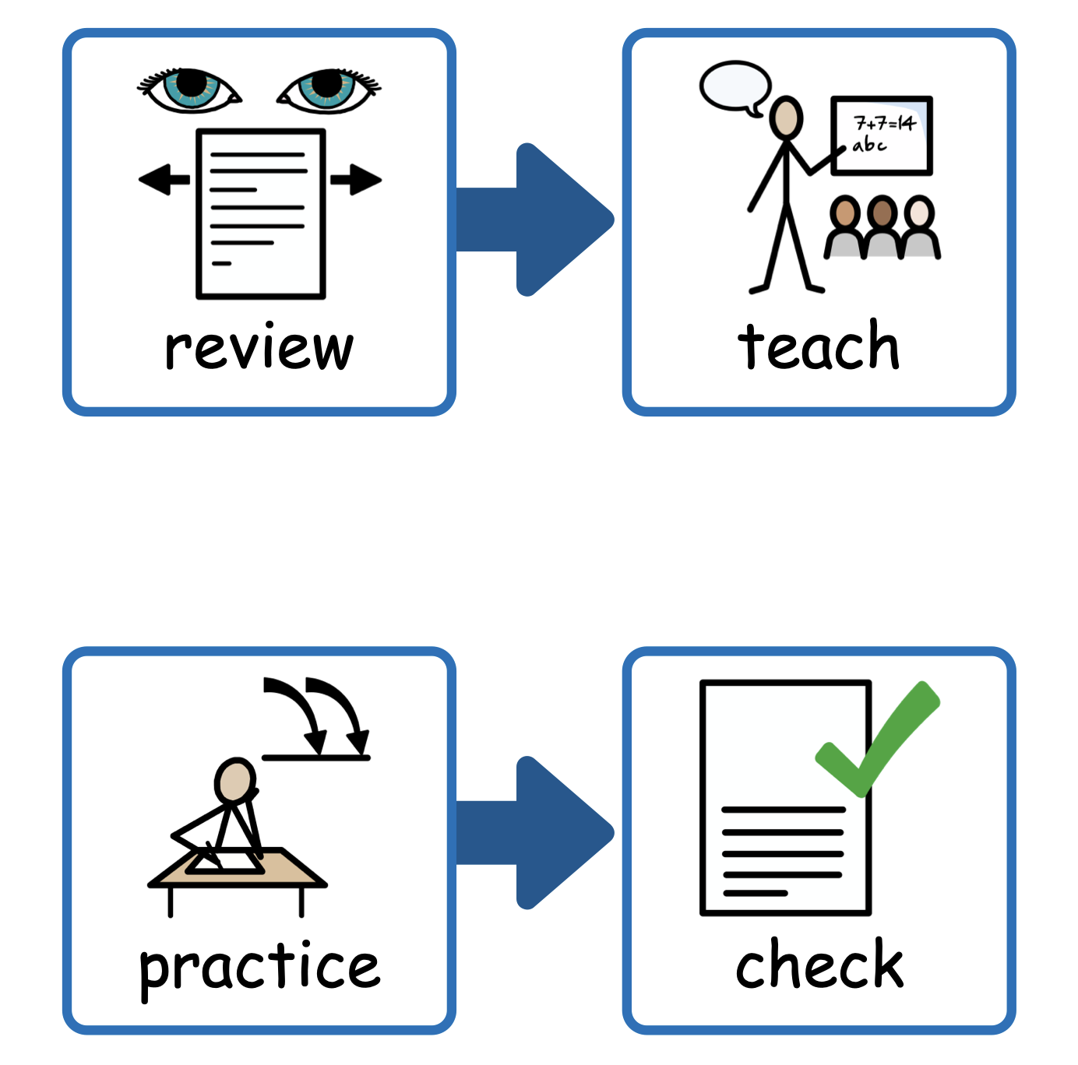
LITERACY + MATHS · SETUP
Set up the table before students arrive
BEN
Within reach—not in view
• literacy card deck
• maths tub + manipulatives
• quiet known task
• AAC/communication supports
• timer + finished tray
ALMA
VISUAL AGENDA
DIEGO
ONLY THE ACTIVE
MATERIALS ON THE TABLE
clipboard + data strip
angled away from students
Choose one subject per session. Keep the other materials covered.
TEACHER
3
Notes:
The diagram shows a three-student group. Only current materials should be visible. Keep AAC and access supports continuously available.

Slide 4
LITERACY + MATHS · LESSON FLOW
Fade support to reveal independence
0-2 min
2-6 min
6-13 min
13-22 min
22-27 min
27-30 min
CHECK IN
REVIEW
TEACH
GUIDED
INDEPENDENT
EXIT PROBE
ready · move · help
known reading or number skill
I do → we do
say · make · read/solve
five new items
score · decide next step
High support early → deliberately faded support → clean independent measure
4
Notes:
The 30-minute structure works for both subjects. Guided practice remains the longest phase because students need many active responses.

Slide 5
LITERACY · TARGET
Literacy target: blend and read CVC words
Students will read
map · sit · fog · hen · cup
Prepare
• sound cards
• magnetic letters
• continuous-blending strip
• word/picture cards
• five-word exit probe
Target the blending process, not memorization. Students say each sound, sweep through the word, then read it as a whole word.
Measure: unfamiliar CVC words read independently
5
Notes:
Use only letter-sound correspondences students have already been taught in the school's sequence.

Slide 6
LITERACY · REVIEW
Settle students and retrieve known sounds
0:00-2:00 · regulation check
2:00-6:00 · rapid review
YOU SAY
“First sounds, then words, and finally a quick read. Are you ready, do you need movement, or do you need help?”
/m/
/a/
ma
“Listen: /m/ … /a/. Touch, slide, say: ma. Now add /p/: map.”
• Student points to one choice
• 30-second strategy if needed
• Student names the first agenda item
5 quick trials: + independent P prompted − incorrect
6
Notes:
Use previously taught sounds during review. This phase is retrieval practice, not the formal probe.

Slide 7
LITERACY · TEACH
Model continuous blending without guessing
I DO
WE DO
YOU DO
Model two words
Blend together three times
Give one individual turn
map
sit
fog
hen
cup
Teacher script: “Watch my finger: /m/ /a/ /p/, map. I keep the sounds connected. My turn. Together. Your turn.”
7
Notes:
Model the exact blending routine used by the core programme. Avoid picture guessing during the decoding response.

Slide 8

LITERACY · GUIDED PRACTICE
Guided literacy practice keeps every student responding
1
2
3
4
BUILD
BLEND
READ
TRANSFER
m · a · p
map
map →
sit
Build with magnetic letters
Sweep and blend the sounds
Read, then match
Try a new word with less help
Correction: “My turn → together → your turn” — then revisit with a different word
8
Notes:
Aim for five to eight meaningful reading responses per student. Record the least intrusive prompt used.

Slide 9
LITERACY · INDEPENDENT
Can students decode without teaching help?
“Read each word. Use your sound-and-sweep strategy.”
Student task strip
1. map □
2. sit □
3. fog □
4. hen □
5. cup □
Present five new-but-similar words. Allow normal IEP access supports. Observe quietly and save reteaching until the set is finished.
Record: independent correct ÷ 5 + support used
9
Notes:
If teaching help is given, code that item as prompted rather than independent.

Slide 10
LITERACY · PROBE
The literacy probe tells you what to teach next
Probe words
jam · net · lip · hot · bus
Fictional results
• Alma 4/5 · reteach short e
• Ben 3/5 · fade pointing cue
• Diego 5/5 · move to phrases
• Next lesson follows the error pattern
Give the same direction and wait time. Do not correct between probe items. Record the exact response when it explains the error.
Probe = brief measurement, not another lesson
10
Notes:
These results are fictional. Use the school's approved progress-monitoring procedure and each student's required accommodations.

Slide 11
MATHS · TARGET
Maths target: add within 10 using representations
Students will solve
5 + 2 = 7
Prepare
• two-color counters
• ten frames
• number cards
• dry-erase boards
• five-item exit probe
Students build the quantities, combine them, explain what changed, then connect the model to the number sentence.
Measure: correct answer + representation + strategy
11
Notes:
Use the representations and mathematical language expected by HoLa's approved mathematics curriculum.

Slide 12
MATHS · REVIEW
Settle students and retrieve number facts
0:00-2:00 · regulation check
2:00-6:00 · rapid review
YOU SAY
“First numbers, then building, and finally a quick solve. Are you ready, do you need movement, or do you need help?”
5
+2
7
“Show five. Add two more. Count on: five…six, seven.”
• Student points to one choice
• 30-second strategy if needed
• Student names the first agenda item
5 quick trials: + independent P prompted − incorrect
12
Notes:
Review familiar quantities, counting-on routines, or number bonds before teaching the new example.

Slide 13
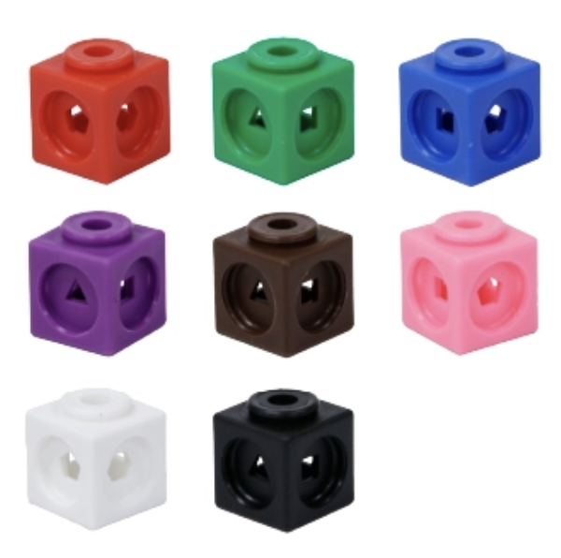
MATHS · TEACH
Connect concrete materials to the number sentence
I DO
WE DO
YOU DO
Build and think aloud
Build together twice
Give one individual turn
make 5
add 2
count on
5 + 2
= 7
Teacher script: “I have five. I add two more. Five…six, seven. The total is seven, so 5 + 2 = 7.”
13
Notes:
Keep the manipulatives organised so students can see the two parts and the combined total.

Slide 14
MATHS · GUIDED PRACTICE
Move maths practice from objects to symbols
1
2
3
4
BUILD
SAY
DRAW
WRITE
6 + 2
total = 8
●●●●●● + ●●
6 + 2 = 8
Build both parts with counters
Explain: six and two make eight
Sketch the ten-frame
Write and read the equation
Correction: rebuild the quantities → count on together → give a fresh problem independently
14
Notes:
Alternate turns and ensure each student manipulates, explains, draws, or writes rather than only watching.

Slide 15
MATHS · INDEPENDENT
Can students solve with support faded?
“Build or draw each problem, then write the total.”
Student task strip
1. 4 + 2 = ___
2. 6 + 1 = ___
3. 5 + 3 = ___
4. 7 + 2 = ___
5. 3 + 4 = ___
Give five new-but-similar problems. Students may use their normal manipulatives or visual supports, but teaching prompts are recorded separately.
Record: independent correct ÷ 5 + representation used
15
Notes:
Accommodations provide access. A cue that teaches the answer should be coded as a prompt.

Slide 16
MATHS · PROBE
The maths probe identifies the next instructional step
Probe items
2+5 · 4+3 · 6+2 · 5+4 · 7+1
Fictional results
• Alma 4/5 · count on from larger
• Ben 3/5 · fade ten-frame cue
• Diego 5/5 · explain two strategies
• Next lesson follows strategy data
Use the same direction and wait time. Record accuracy, representation, and whether the student counted all, counted on, or recalled the fact.
Measure the goal—not speed or compliance
16
Notes:
These results are fictional. Follow the school's progress-monitoring procedure and IEP accommodations.

Slide 17
LITERACY + MATHS · ACCESS
Keep the target; vary how each student accesses it
ALMA
BEN
DIEGO
Visual choices + reduced field
First-then + brief movement break
Word-to-sentence or equation explanation
sound cards
counters
AAC
one-step cue
extension
Change the response mode, visual field, language load, item count, regulation support, or extension—not the core target.
17
Notes:
Fictional students illustrate access planning. Actual supports must come from IEPs, classroom data, and team decisions.

Slide 18
LITERACY + MATHS · PROMPTS
Prompt, fade, then test independence
1
2
3
4
WAIT
GESTURE
VERBAL CUE
MODEL
5 seconds
point or sweep
“look at the first part”
“my turn”
Give processing time
Direct attention without the answer
Cue the known strategy
Demonstrate, then practice together
After a prompted success, give a fresh item independently—otherwise you only know the prompt worked
18
Notes:
Use the student's planned prompting hierarchy when one exists. Record the least intrusive prompt that produced success.

Slide 19
LITERACY + MATHS · RUN SHEET
Use the same run sheet; change the target and materials
0-2 min
2-6 min
6-13 min
13-22 min
22-27 min
27-30 min
CHECK IN
REVIEW
TEACH
GUIDED
INDEPENDENT
EXIT PROBE
readiness note only if relevant
5 known trials · + / P / −
model one target
5-8 active turns each
correct ÷ 5 + support
score + next lesson decision
After the group: What will I keep, reteach, extend, or fade tomorrow?
19
Notes:
Before each session, replace the example target with the student's IEP-linked skill and the school's approved curriculum task.

