Slide 1
TWO REALISTIC GRADE 2–3 CLASSROOM WALK-THROUGHS
join
↓
support
↓
fade
↓
rejoin
Special Education push-in sessions
Teacher roles · subject examples · access supports · prompts · data · transitions
Illustrative Grade 1-2 group of three students
Kaylen M. Brignall, M.A.
1
Notes:
The deck shows one English literacy example and one mathematics example using the same push-in principles.
[Sources]
- User-provided push-in teaching brief and prior mathematics deck
[/Sources]

Slide 2
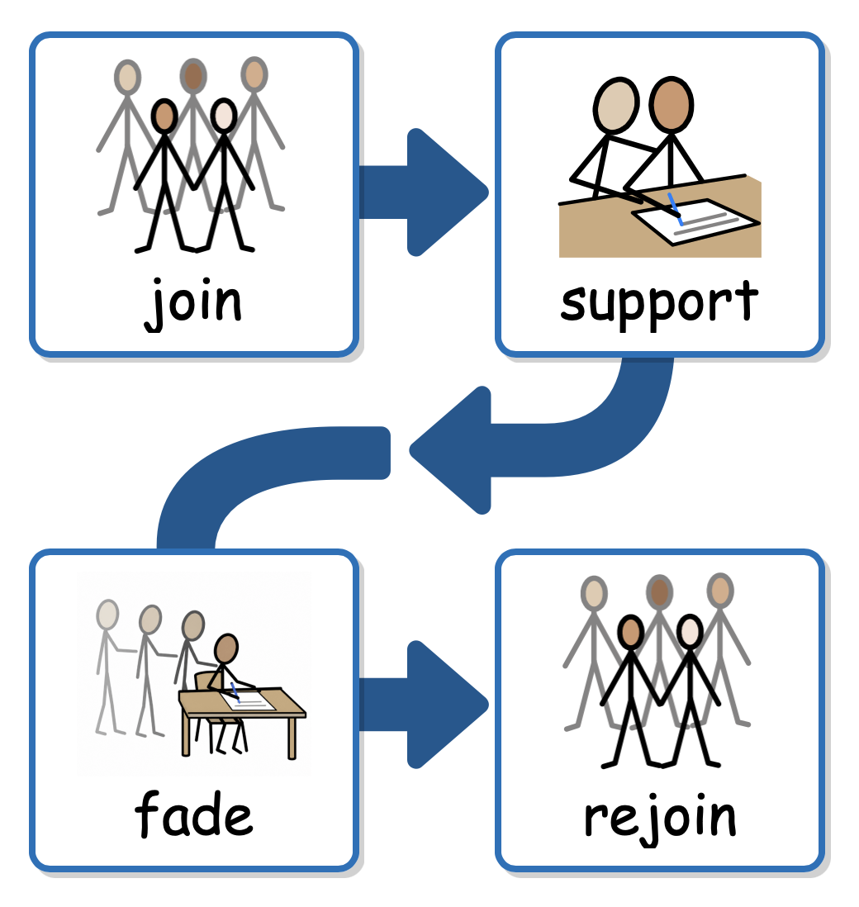

Slide 3
ENGLISH + MATHS · PURPOSE
Support access without taking over
TWO CLASS LESSONS
English: main idea + details
Maths: add 38 + 24
Fictional focus students
• Maya · autism · AAC available
• Leo · global delay · reduced language
• Both join each whole-class launch
• Support follows IEP needs—not diagnosis
The class target stays shared. The special educator changes access, response mode, practice amount, and prompting so students participate more independently.
Success = meaningful participation with support deliberately faded
2
Notes:
The examples use fictional students. Match all supports to actual IEPs and classroom expectations.
[Sources]
- User-provided push-in teaching brief and prior mathematics deck
[/Sources]

Slide 4
ENGLISH + MATHS · BEFORE CLASS
Agree on the target and adult roles before students enter
FOCUS
Two-minute pre-brief
• What is today’s target?
• Where might access break down?
• Who leads each phase?
• Which prompt ladder will we use?
• How will students rejoin?
PEERS
SPED
WHOLE-CLASS
instruction continues
with the classroom teacher
FOCUS STUDENT
works beside peers with
accessible materials
SPECIAL EDUCATOR
joins, prompts, fades,
and records one data point
Enter quietly, use the classroom routine, and position support so the student can still see the teacher and nearby peers.
CLASS
3
Notes:
This diagram represents a push-in classroom: instruction continues, support joins the existing setting, and the student remains connected to peers.
[Sources]
- User-provided push-in teaching brief and prior mathematics deck
[/Sources]

Slide 5
PUSH-IN · SHARED FLOW
Use one predictable rhythm in both subjects
0-2 min
2-6 min
6-13 min
13-22 min
22-27 min
27-30 min
CHECK IN
REVIEW
TEACH
GUIDED
INDEPENDENT
EXIT PROBE
materials ready · quiet check-in
join class model · preview visuals
parallel teach or reteach one step
student responds with support faded
record one clean data point
share success · rejoin class
The content changes; the access routine stays familiar
4
Notes:
Use the sequence flexibly around the classroom timetable.
[Sources]
- User-provided push-in teaching brief and prior mathematics deck
[/Sources]

Slide 6
ENGLISH · SHARED TARGET
Keep the literacy target visible
Students will identify
the main idea + two details
Prepare access tools
• enlarged or chunked passage
• line guide or reading window
• main idea / detail visual
• vocabulary picture cards
• AAC words: topic · idea · detail
Students read a short informational paragraph, name what it is mostly about, select the most important idea, and point to two sentences that support it.
Measure: correct main idea + two supporting details + prompting
5
Notes:
Use the class text and the reading supports specified in the student's plan.
[Sources]
- User-provided push-in teaching brief and prior mathematics deck
[/Sources]

Slide 7
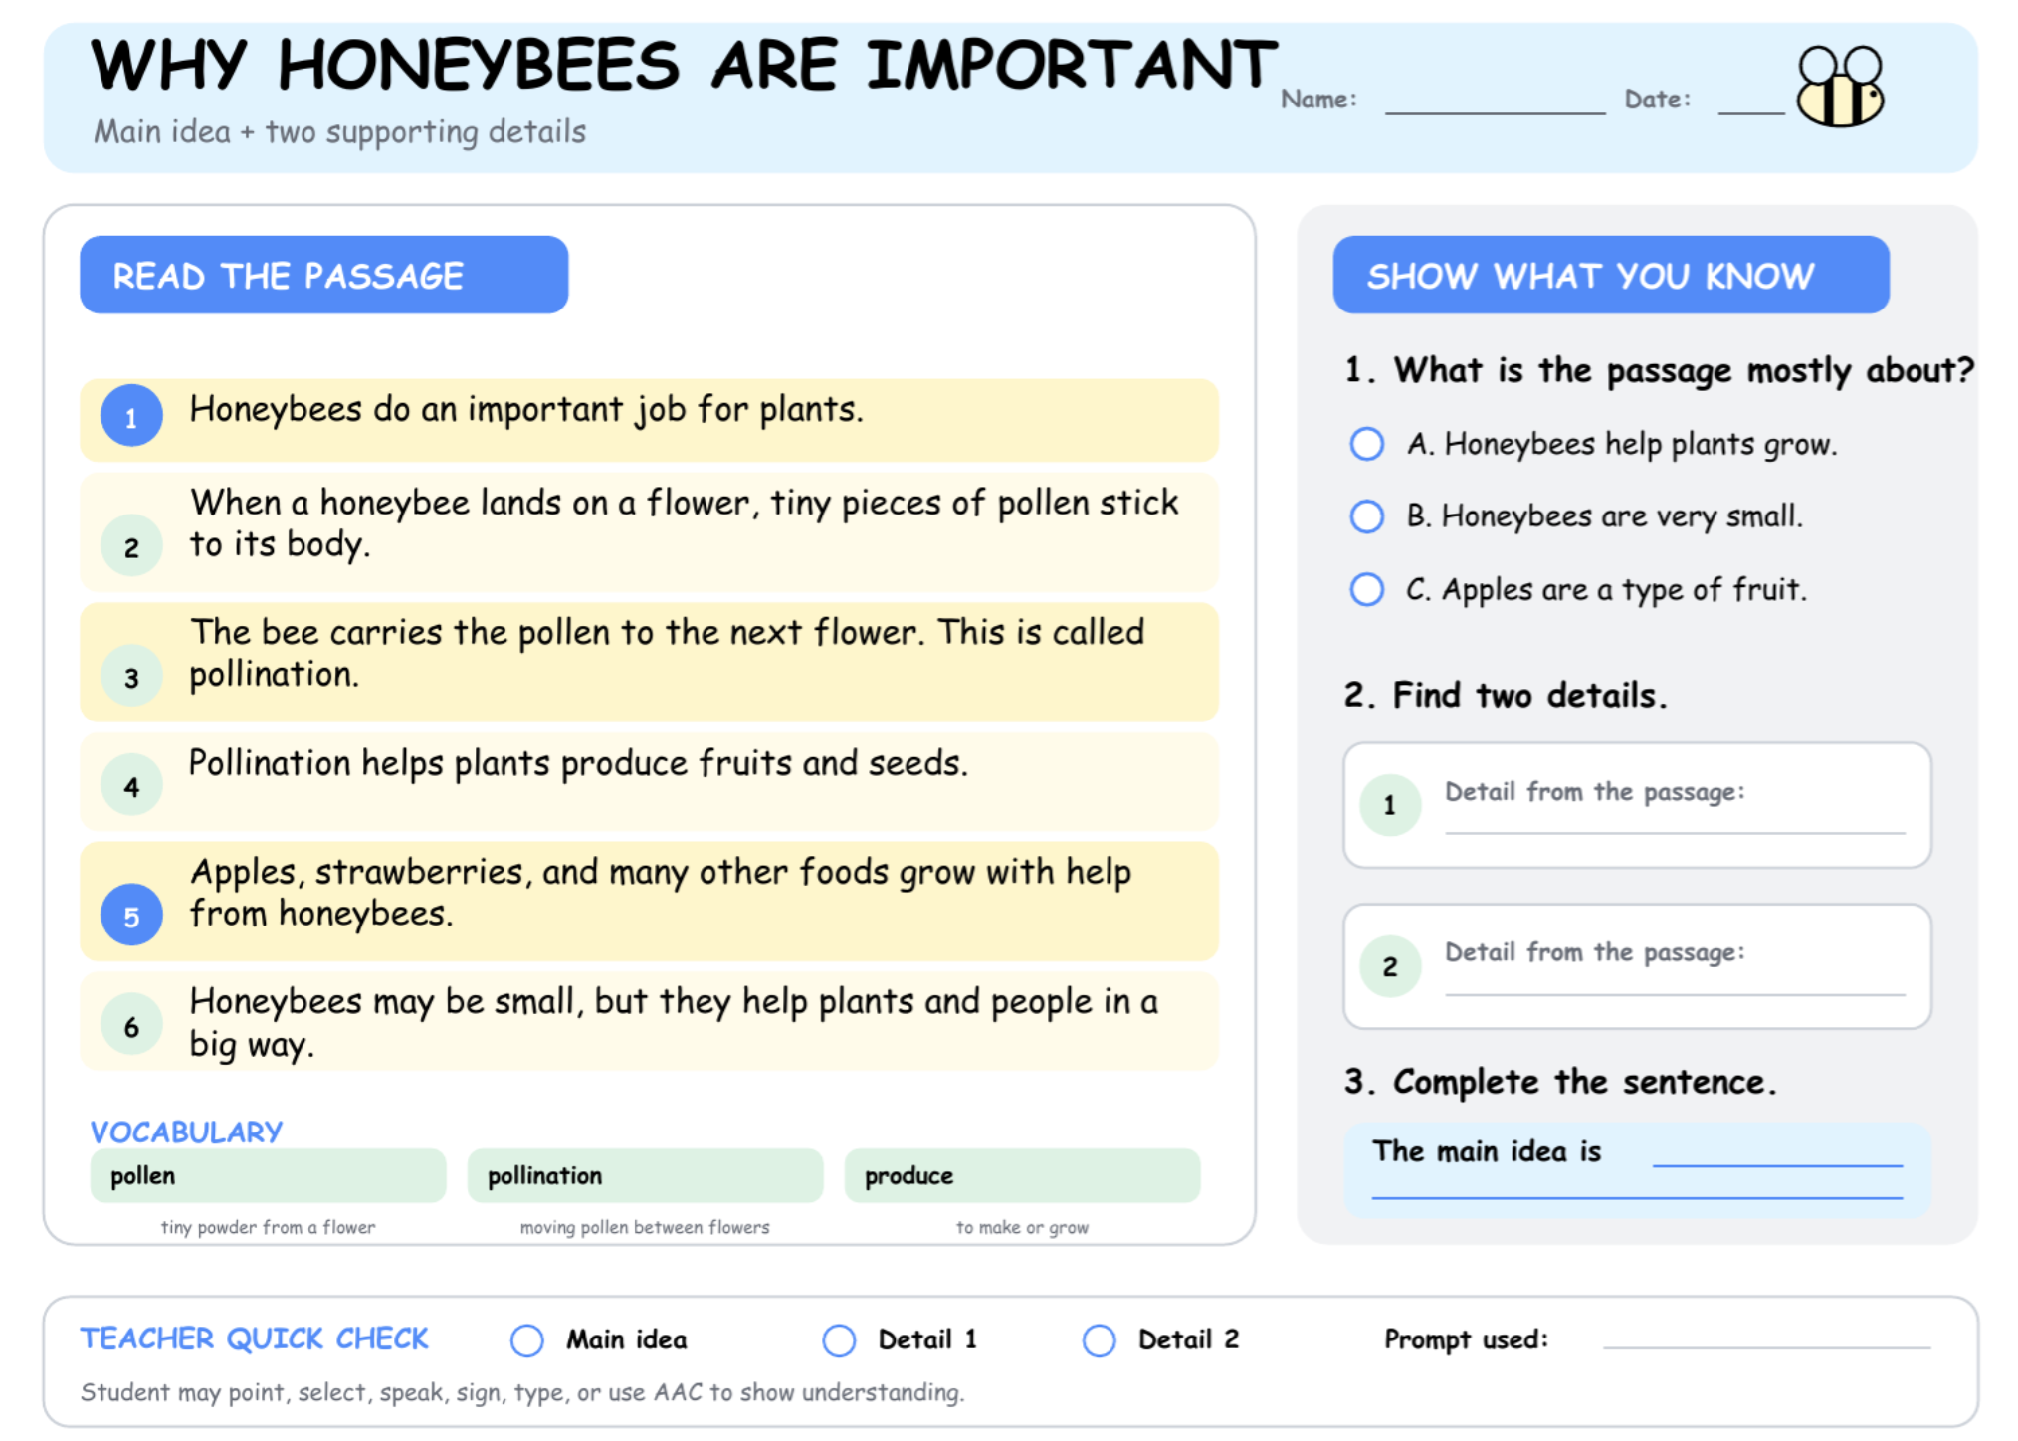

Slide 8


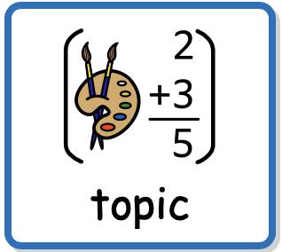


PARALLEL TEACHING
Read the same text with a smaller group
SAME TEXT
SMALLER GROUP
SHARED CHECK
class passage about honeybees
three to six students beside the class
everyone answers the class
question
preview words
read chunk
name topic
choose idea
find proof
Special educator: “We are reading the same paragraph. First, name the topic. Now ask: what is the author mostly teaching us? Show the sentence that proves it.”
6
Notes:
Parallel teaching should preserve the shared text and essential comprehension target.
[Sources]
- User-provided push-in teaching brief and prior mathematics deck
[/Sources]

Slide 9

ENGLISH · RETEACH
Reteach the difference between an idea and a detail
NOTICE
RETEACH
RETURN
student chose one interesting fact
idea covers the whole paragraph
answer with a fresh paragraph
read all
name topic
ask mostly
choose idea
prove it
Teacher script: “A detail tells one part. The main idea covers the whole paragraph. Which answer fits every sentence? Now prove it with two details.”
7
Notes:
Correct the specific misconception, then use a fresh item before returning to the class task.
[Sources]
- User-provided push-in teaching brief and prior mathematics deck
[/Sources]

Slide 10
ENGLISH · RESPONSE OPTIONS
Let students show comprehension in different ways
0:00-2:00 · regulation check
2:00-6:00 · rapid review
YOU SAY
“Show the main idea: say it, select it, type it, point to it, or build the sentence with word cards.”
IDEA
+
DETAILS
Accept a spoken, signed, selected, typed, or AAC response when it reveals comprehension. Reading aloud and understanding are different targets.
• Keep the same text and question
• Do not require oral reading to prove comprehension
• Ask the student to identify evidence
Record comprehension separately from decoding, speech, handwriting, and speed
8
Notes:
Use a response mode that measures the intended literacy skill rather than an unrelated motor or speech demand.
[Sources]
- User-provided push-in teaching brief and prior mathematics deck
[/Sources]

Slide 11
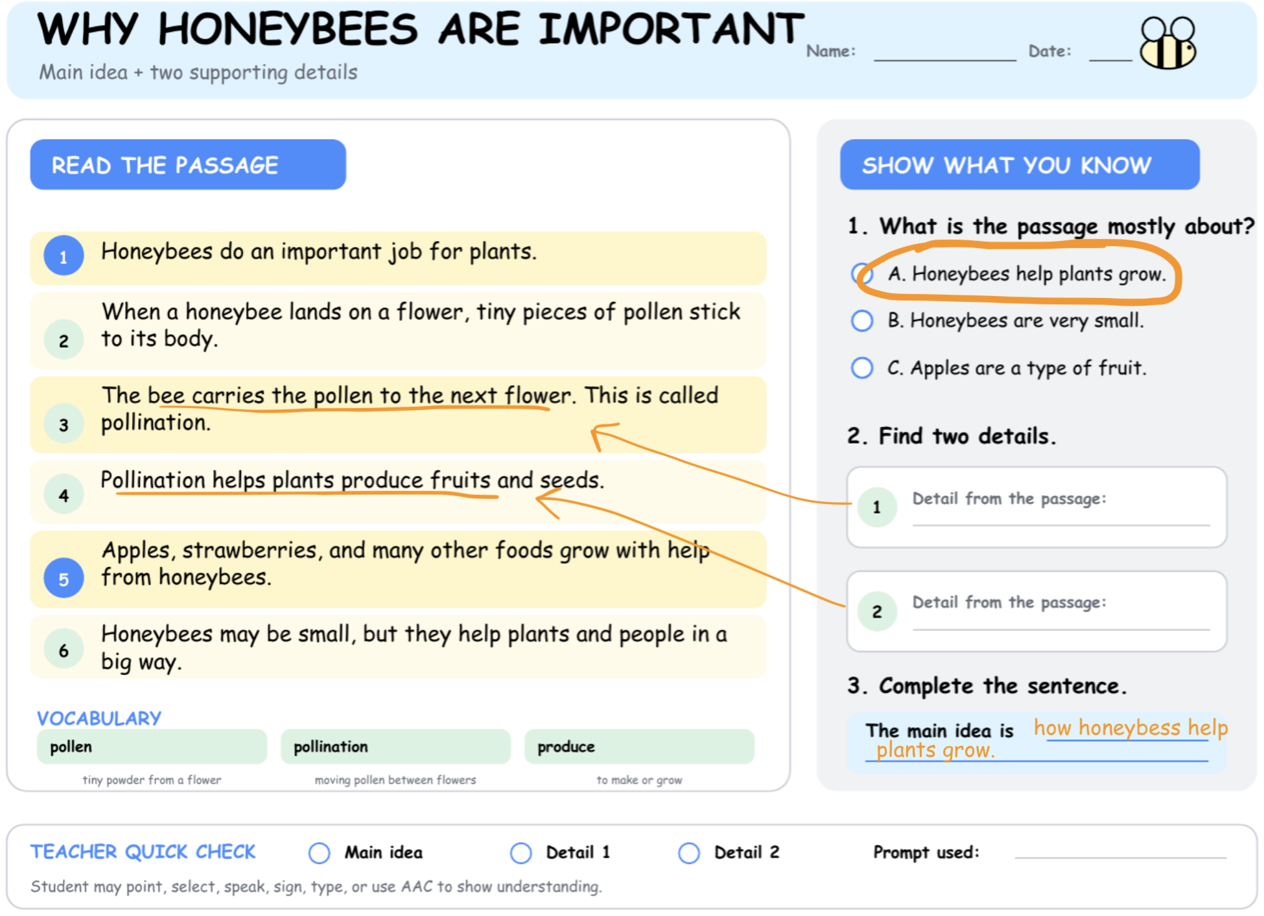

Slide 12
ENGLISH + MATHS · STARTING
Make the first action obvious
START IN THREE MOVES
1. Point to item 1
2. Choose the tool
3. Complete the first step
Visual task strip
□ point to the first item
□ choose text tool or maths tool
□ complete the first step
□ continue to the check point
□ place work in finished tray
Give one concise direction, show the three-step strip, wait, and reinforce the start. Once work begins, fade proximity and return at the agreed check point.
Data: started within 10 seconds · independent / gesture / verbal / model
9
Notes:
Task initiation support should clarify how to start without completing the work for the student.
[Sources]
- User-provided push-in teaching brief and prior mathematics deck
[/Sources]

Slide 13
SHARED PROMPT HIERARCHY
Use the same prompt ladder across subjects
WAIT
LEAST TO MOST
FADE
allow 5–10 seconds
increase help only when needed
test a fresh item independently
wait
gesture
brief cue
model
physical*
English cue: “Check the title.” Maths cue: “Check the ones.” Model on a different example, then present a fresh item. *Physical guidance only when appropriate and authorized.
10
Notes:
Adults should define and record prompts consistently.
[Sources]
- User-provided push-in teaching brief and prior mathematics deck
[/Sources]

Slide 14
SHARED LANGUAGE ACCESS
Reduce language and preserve thinking time
0:00-2:00 · regulation check
2:00-6:00 · rapid review
YOU SAY
Instead of giving several directions, state one observable action: “Underline the topic” or “Count the ones.”
I
DO
WAIT
Watch quietly during processing time. Extra explanation can increase the demand and hide what the student independently understands.
• Use the same wording once
• Pause for 5–10 seconds
• Add a visual before more language
Observe: response after wait · after visual · after brief cue
11
Notes:
Processing time and reduced language apply across subjects.
[Sources]
- User-provided push-in teaching brief and prior mathematics deck
[/Sources]

Slide 15
SHARED VISUAL ROUTINE
Show what is happening now and what comes next
0:00-2:00 · regulation check
2:00-6:00 · rapid review
YOU SAY
Use: WHOLE CLASS → SMALL GROUP → TRY ONE → SHARE → FINISHED.
WE
DO
NEXT
SHARE
“Now: try one with me. Next: return to your table and share your answer.” Point to each step, then move with the student—not ahead of them.
• Preview the move
• Carry AAC and needed tools
• Use the same finished location
• Give a transition warning
Transition data: visual only / verbal cue / adult escort
12
Notes:
The visual routine should travel with the student across settings and subjects.
[Sources]
- User-provided push-in teaching brief and prior mathematics deck
[/Sources]

Slide 16
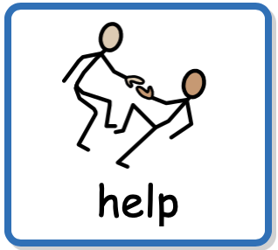
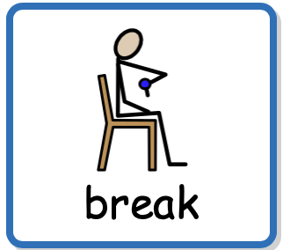



SHARED COMMUNICATION
Teach requests that work in every lesson
MODEL
HONOUR
RETURN
point to or use the message
respond quickly when possible
support re-entry after the need
is met
help
break
more time
read it
my answer
Adult model: “You can say, sign, or select ‘help.’” Give one useful support, then pause: “You asked for help. Now you try.” Keep AAC available throughout.
13
Notes:
Functional communication is part of access, not a reward for compliance.
[Sources]
- User-provided push-in teaching brief and prior mathematics deck
[/Sources]

Slide 17
ENGLISH · QUICK DATA
Collect a small literacy data set
FOCUS SKILL
Main idea + two supporting details
Fictional data strip
Item 1 · main idea correct · gesture
Detail 1 · correct · independent
Detail 2 · incorrect · verbal cue
Initiated task · visual only
Rejoined class · independent
Score three planned opportunities. Note accuracy, response mode, and the least intrusive prompt. Keep decoding information separate when comprehension is the target.
Decision: keep line guide · fade pointing cue · reteach evidence selection
14
Notes:
The data are fictional. Use the school's required system and each student's operational definitions.
[Sources]
- User-provided push-in teaching brief and prior mathematics deck
[/Sources]

Slide 18
ENGLISH · REJOINING
Return with an answer the student can contribute
REJOIN IN THREE STEPS
1. Finish one successful response
2. Mark the evidence
3. Carry the text back to the class
Adult hand-off language
“You chose the main idea and highlighted two details. Take the passage back. Your class is discussing detail two. Show or say the evidence you found.”
Give the student a purposeful role: share the selected main idea, point to one supporting detail, compare answers with a peer, or begin the same written response as classmates.
Fade: check once after re-entry, then step away at the agreed point
15
Notes:
Connect re-entry directly to the live class discussion or task.
[Sources]
- User-provided push-in teaching brief and prior mathematics deck
[/Sources]

Slide 19
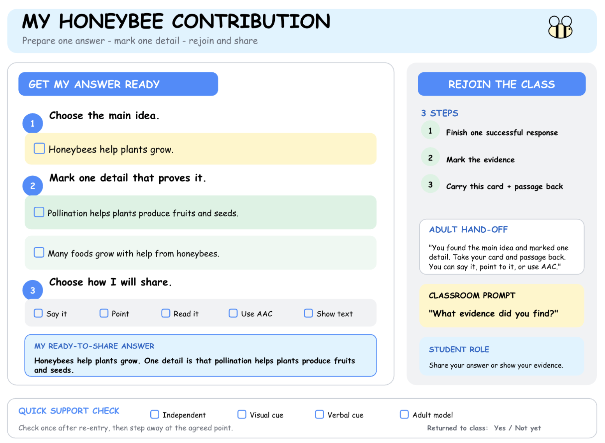

Slide 20
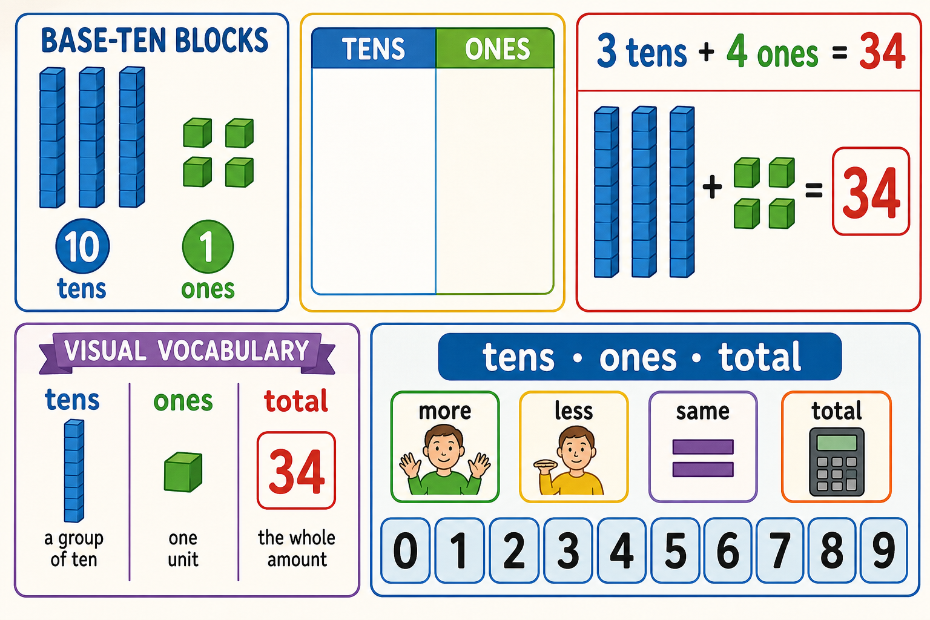
MATHS · SHARED TARGET
Keep the mathematics target visible
Students will solve
38 + 24 = 62
Prepare access tools
• base-ten blocks or place-value discs
• tens/ones mat
• worked-example strip
• visual vocabulary: tens · ones · total
• AAC maths words or number board
Students build tens and ones, regroup ten ones as one ten, connect the model to the equation, and explain their strategy.
Measure: correct representation + equation + level of prompting
16
Notes:
Maintain the shared grade-level target while adjusting access and entry point.
[Sources]
- User-provided push-in teaching brief and prior mathematics deck
[/Sources]

Slide 21
MATHS PARALLEL
Teach the same maths target to a smaller group
SAME TARGET
SMALLER GROUP
SHARED CHECK
38 + 24 with tens and ones
three to six students beside the class
everyone returns to one exit task
build 38
add 24
combine ones
regroup 10
write 62
Special educator: “Build 38. Add 24. Count the ones. Trade ten ones for one ten. Now count tens, then ones. What is the total?”
17
Notes:
Coordinate mathematical vocabulary and representations with the classroom teacher.
[Sources]
- User-provided push-in teaching brief and prior mathematics deck
[/Sources]

Slide 22
MATHS RETEACH
Reteach the exact mathematical breakdown
NOTICE
RETEACH
RETURN
student counted all blocks as ones
make one ten from ten ones
solve a fresh class problem
34 + 18
4 + 8 ones
12 ones
trade 10
52 total
Teacher script: “Twelve ones is more than nine. Circle ten ones. Trade them for one ten. Now count tens, then ones. Try 26 + 17 with less help.”
18
Notes:
Keep reteaching brief and diagnostic.
[Sources]
- User-provided push-in teaching brief and prior mathematics deck
[/Sources]

Slide 23
MATHS · RESPONSE OPTIONS
Change the response mode—not the mathematics
0:00-2:00 · regulation check
2:00-6:00 · rapid review
YOU SAY
“Show your answer in the clearest way: build it, draw it, point to it, choose it, say it, or type it.”
31
+
11
62
Accept a model, drawing, selected equation, spoken response, signed response, or AAC response when it demonstrates the intended understanding.
• Keep the same numbers and concept
• Offer only useful choices
• Ask for a strategy at the student’s level
Record the mathematics—not speech length, handwriting, eye contact, or speed
19
Notes:
The alternate response must still reveal the targeted mathematical understanding.
[Sources]
- User-provided push-in teaching brief and prior mathematics deck
[/Sources]

Slide 24
MATHS DATA
Collect a small mathematics data set
FOCUS SKILL
Add using a place-value model
Fictional data strip
Item 1 · correct · gesture
Item 2 · correct · independent
Item 3 · incorrect · verbal cue
Initiated task · visual only
Rejoined class · independent
Score three planned opportunities. Note accuracy, representation, strategy, and the least intrusive prompt. Avoid tallying every classroom behavior.
Decision: keep place-value mat · fade proximity · reteach regrouping
20
Notes:
The data are fictional. Follow school procedures and IEP accommodations.
[Sources]
- User-provided push-in teaching brief and prior mathematics deck
[/Sources]

Slide 25
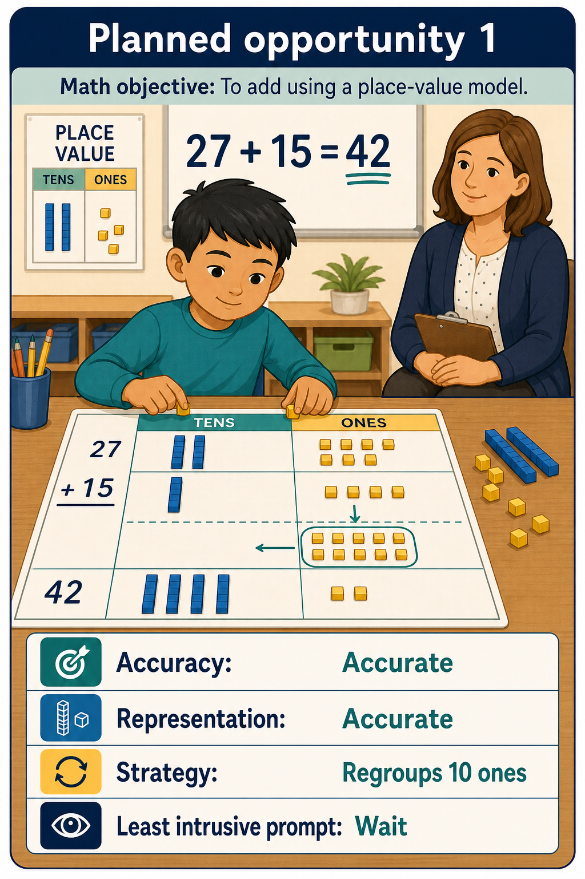
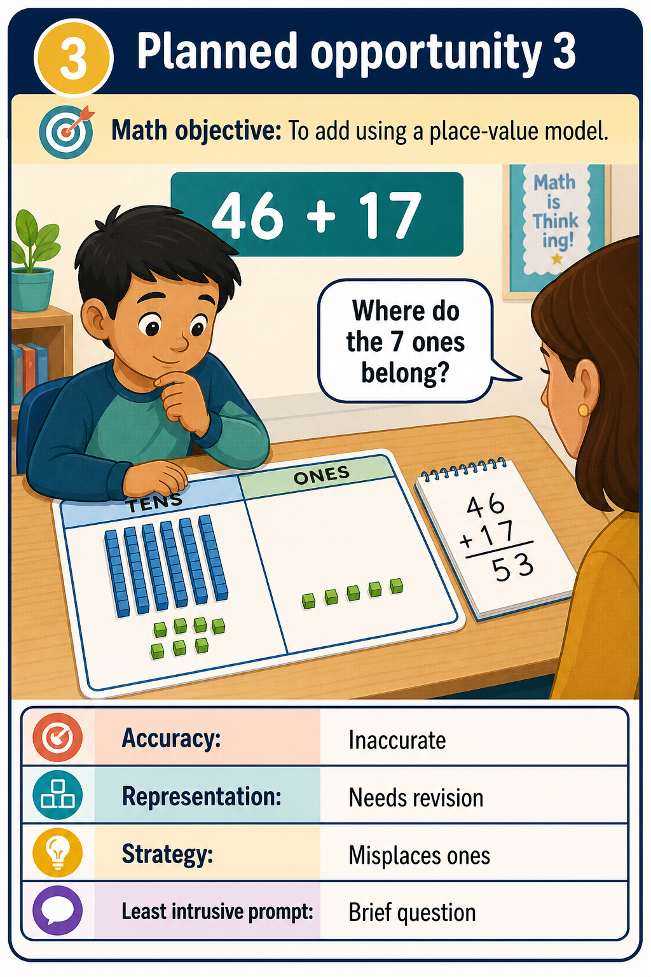
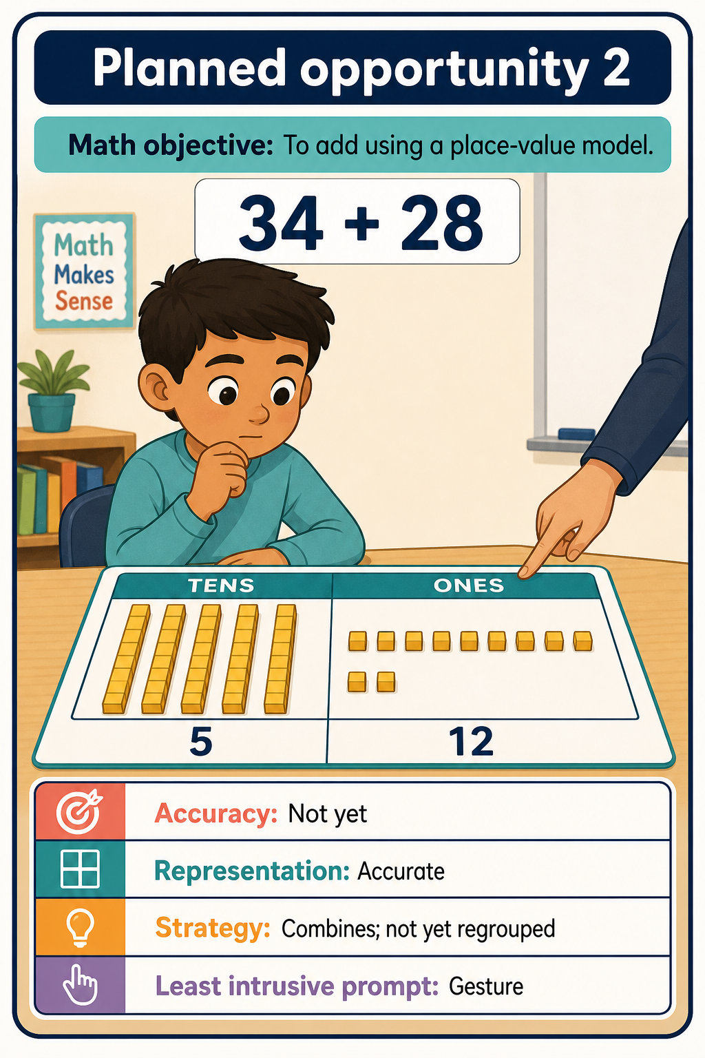

Slide 26
MATHS · REJOINING
Return with a model the student can use
REJOIN IN THREE STEPS
1. Finish one success
2. Name or show the strategy
3. Carry the model back to class
Adult hand-off language
“You solved 38 + 24 by trading ten ones for one ten. Take your model back. Your class is solving problem 4. Start there; I’ll check once.”
The student might place the model under the document camera, compare answers with a peer, or begin the same independent problem as classmates.
Fade: step away after the agreed check—not after dependence develops
21
Notes:
Plan the route back before the small-group support begins.
[Sources]
- User-provided push-in teaching brief and prior mathematics deck
[/Sources]

Slide 27
THE REAL OBJECTIVE
Participation is not the same as quiet compliance
DO NOT MEASURE ONLY
quiet body · eye contact · sitting still · fast completion
Look for instead
• begins a meaningful step
• uses text or materials purposefully
• communicates help or break
• demonstrates the target skill
• returns to the group
• needs less prompting over time
A student may regulate through movement, communicate without speech, or need extra processing time and still be deeply engaged. Measure access, understanding, communication, and independence.
Goal: greater agency and participation—not adult-controlled appearance
22
Notes:
Academic and functional objectives must remain visible.
[Sources]
- User-provided push-in teaching brief and prior mathematics deck
[/Sources]

Slide 28
ENGLISH · WALK-THROUGH
What one English literacy visit could look like
0-2 min
2-6 min
6-13 min
13-22 min
22-27 min
27-30 min
CHECK IN
REVIEW
TEACH
GUIDED
INDEPENDENT
EXIT PROBE
preview text · AAC and line guide ready
join launch · listen for class question
parallel read · model main idea routine
fresh paragraph · prompts faded
score idea + two details
student shares evidence · adult steps away
The student ends in the class discussion with a usable reading strategy
23
Notes:
This is an illustrative English sequence.
[Sources]
- User-provided push-in teaching brief and prior mathematics deck
[/Sources]

Slide 29
MATHS · WALK-THROUGH
A realistic mathematics push-in visit
0-2 min
2-6 min
6-13 min
13-22 min
22-27 min
27-30 min
CHECK IN
REVIEW
TEACH
GUIDED
INDEPENDENT
EXIT PROBE
place-value mat · AAC ready
join launch · preview tens and ones
parallel group · model 38 + 24
fresh problem · prompts faded
score three items + initiation
student shares model · adult steps away
The student ends on the class task with a usable mathematics strategy
24
Notes:
This is an illustrative mathematics sequence.
[Sources]
- User-provided push-in teaching brief and prior mathematics deck
[/Sources]

Slide 30
ENGLISH + MATHS · RUN SHEET
Use one simple plan every time you enter the classroom
0-2 min
2-6 min
6-13 min
13-22 min
22-27 min
27-30 min
CHECK IN
REVIEW
TEACH
GUIDED
INDEPENDENT
EXIT PROBE
target + barrier + agreed roles
visuals · AAC · subject tools ready
teach or reteach one precise step
wait · prompt · fade · fresh attempt
accuracy + independence + prompt
share success · rejoin · next decision
Ask after every visit: Did my support increase access now—and independence next time?
25
Notes:
Replace the examples with the current class objective and the student's IEP-linked priority.
[Sources]
- User-provided push-in teaching brief and prior mathematics deck
[/Sources]

